Slide 1

INF20028 Professional Capabilities for a Digital World
Dr Jason Sargent
Convenor
jpsargent@swin.edu.au
+61 3 9214 5287
Stuart McLoughlin
smcloughlin@swin.edu.au

Slide 2
Roadmap for this class
Introductions
What, where & how
Unit delivery structure
Assessment structure
(Informal) Professional Expectations
Critical Thinking Deep Dive
Q+A, Unit Anxiety Triaging

Slide 3
A Professional’s Core Competencies
Discipline –specific skill sets
The specific knowledge and capabilities that are crucial for a student to progress academically and professionally in their chosen field.
Requirements analysis modelling, business process modelling, coding, slice-n-dice (Tableau, Power BI tools), databases, cloud, web dev, threat assessments, penetration testing, …
21st Century transferable skills sets and competencies
See next slide
Industry Awareness
What are the drivers? Where is the industry headed? Who are the ‘players’
What is the regulatory and governance environment?
What pathways through the industry are possible?

Slide 4
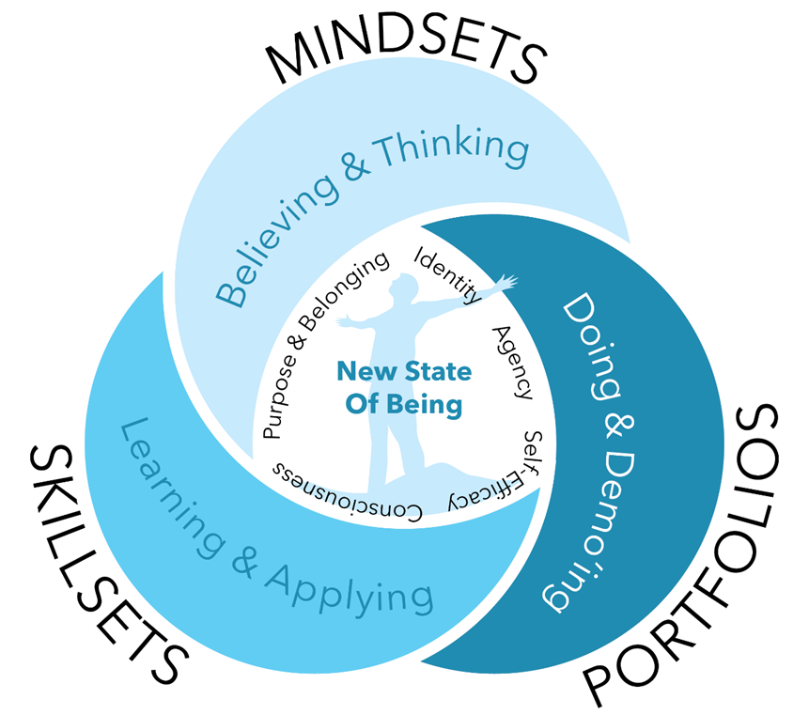

What’s this INF20028 thing about?
The functional skills and mind sets that make someone desirable to an organisation
Every single job interview will address these general skills and mind sets
They are professional skills that allow you to work well with others, apply knowledge to solve problems and fit into any work environment

Slide 5
1-2
1-
PROFESSIONALISM & SKILLS FRAMEWORK FOR THE INFORMATION AGE (SFIA)
Let’s Get ethical!
3--4
1-
Data Ethics & Data Governance
Privacy
5
Group Dynamics, Leadership & Communication
2
3
Wicked Problems & The VUCA World
INVESTIGATIVE
CASE STUDY
Professional Belonging:
CoPs & Social Capital
6-7
8
Justice, Equity, Diversity & Inclusion (JEDI)
9
MENTAL HEALTH & POSITIVE COMPUTING (NON TEACHING WEEK / NO F2F CLASS)
Weekly Modules
10
#UpgradeYourWorld & Public Interest Technology (PIT)
Assignments
11
Professionals Australia / Industry Guest
12
UNIT REVIEW

Slide 6

Unit Delivery Structure
There are 2 parts to this semester’s delivery.
Asynchronous Pre-recorded Theory & a set of Learning Activities
(Self-paced, In your own time/preferably before your class)
On-Campus Class
(Is it a tute, a seminar, a lab, …? It’s a Class)
On-Campus Class Catchups are not regurgitation of theory for 2 hrs
These on-campus class components are NOT LECTURES!

Slide 7

Unit Delivery Structure /2
Consultations
Jason Monday: 1-2pm BA1009. After classes. Other times TBC
Other times available by appointment
Discussion Boards
Watercooler Conversations
Very lightly moderated by the Teaching Team
“Yeah,… Nah!” moments. “I could do that, but I won’t bother, no marks,…”.
See how far that attitude gets you in industry.
Release of Materials
Pre-recorded theory is being used from deliveries already conducted this year.
On-campus classroom slides (Some before class, most after the last class of the week)
Delivery of modules published may be speeded up

Slide 8
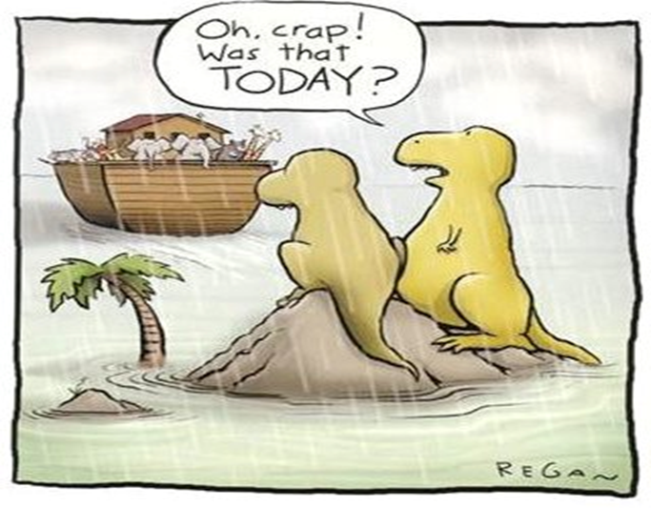

Assessment Structure
There are 3 Assessments
No Exam
Assignment 1 is an individual research paper
Assignment 2 is a group presentation
Assignment 3 is an individual reflection

Slide 9
Assessment Structure /2
Assignment 1
Briefing Paper/Literature Review
Focuses on ULOs 2&3
40% weighting! Please note due date was extended due to Easter Sunday. Now Wed 12/4
A choice of TWO potential topics
Classical Ethical Theory/ies
Ethical Decision-Making Frameworks (Critical Analysis & PEAS)
Edited before submission / No drafts read (Sorry)
Read the Assessment Guidelines & Rubric
Consistent in-text citations / direct quoting & paraphrasing
Follow the APA 7th Referencing Style

Slide 10
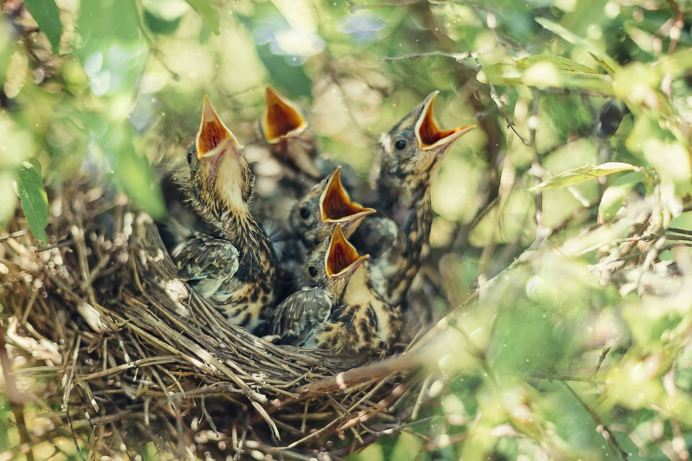

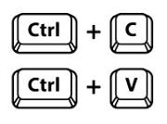
Assessment Structure /3
Assignment 1 / Warning

Slide 11

Assessment Structure /4
Assignment 2
Narrated Powerpoint Presentation
Presentation format is a VIDEO
Focuses on ULOs 1,2,3&4
40% weighting!
Investigative Case Study
Select ONE UNSDG, an associated Wicked Problem with the chosen Goal and propose a Socio-Technical Solution. The solution will be conceptual
All group members to participate
Read the Assessment Guidelines & Rubric
Referencing expected / Follow the required referencing standard

Slide 12
Assessment Structure /5
Assignment 2 Cont.
30% Presentation + 5% Team Charter + 5% Peer Evaluation Survey
Team Charter document is available in the Assignment 2 Folder in Canvas
Peer Evaluation Survey is a Groupwork Contribution Assessment Tool designed by academics within the Swinburne Business School.
You will receive an email to your student account that provides a link to the survey. You will be reminded to complete the survey ONCE. Non-completion = 0/5 for Peer Evaluation
The survey is private to you!
The survey has ‘other questions’ in it related to the actual peer assessment process.

Slide 13
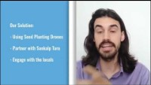
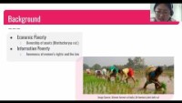
Assessment Structure /6
Assignment 2 Examples from 2021
(Warning: The examples were from the India project Focus & not 2022)

Slide 14
Assessment Structure /7
Assignment 3
Professional Development Reflection
ULOS 2&3
Choose ANY 2 events from the unit modules
Record a 4-minute narrated presentation (or equivalent)
New skills and/or knowledge
Professionalism and Professionalisation
NB: CRITICAL REFLECTION NOT DESCRIPTIVE

Slide 15

Professionals are also engaged in Reflection
Reflection involves thinking about the past, or ongoing experience of events, situations or actions to make sense of them, with a view of informing future choices, decisions and actions. In doing so we draw on existing ideas, our own or other peoples , and in applying them to our experience, we confirm or develop new ideas.

Slide 16


Slide 17




Slide 18
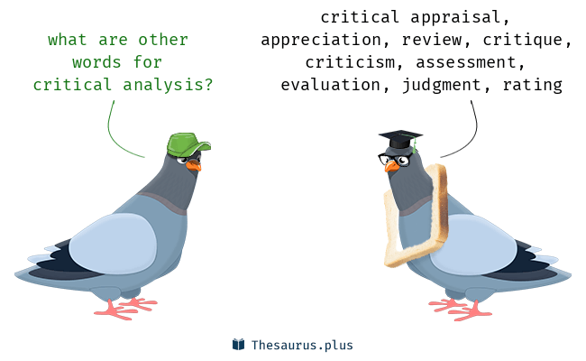
Critical Analysis
What you will need:
Critical Analysis pdf
Open mind
Understanding
So what? What if? What next?
Analysis
How? Why?
Description
Who? What? Where? When?

Slide 19
Critical Analysis /2
Understand the situation
Identify all stakeholders
Isolate the major (ethical dilemma) issue
Identify potential legal implications
Informal guidelines
Formal Guidelines
Ethical principles (see Week/Module 2)

Slide 20




DEEP DIVE: Critical Thinking In pairs or small group, discuss which you would rather do battle with: 1 x HORSE SIZED DUCK OR 100 x DUCK SIZED HORSES?
Critical Thinking Noun: The objective analysis and evaluation of an issue in order to form a judgement.

Slide 21
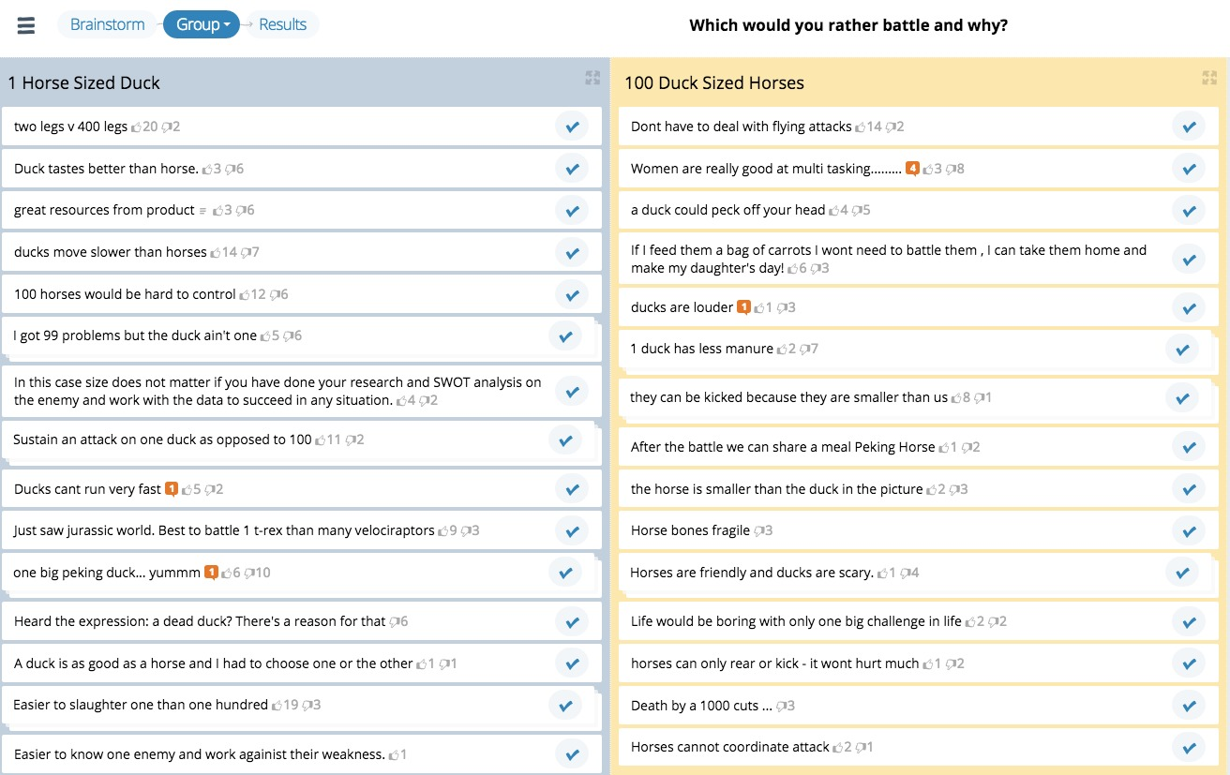

Slide 22

Assessment Bootcamps
Begin officially in Week 2
Final activity of class each week
Bring along your questions to class

Slide 23
Assignment 1 Common Errors
Missing parts: classical ethical theories and principles, ethical decision-making frameworks
No references presented inside the body of the document
Using a different referencing style rather than the required style / Poor quality references / reliance on Wikipedia / outdated references / Inconsistent use of the reference style guide / Not understanding a reference list vs. a bibliography
Too much opinion, lack of balance, lack of synthesis / Too technical
No logical flow to the review / Poorly edited / Death by a thousand paper cuts
No introductory statements to set the scene and/or no conclusion to bring the document to an end
Items mentioned in the rubric are missing

Slide 24

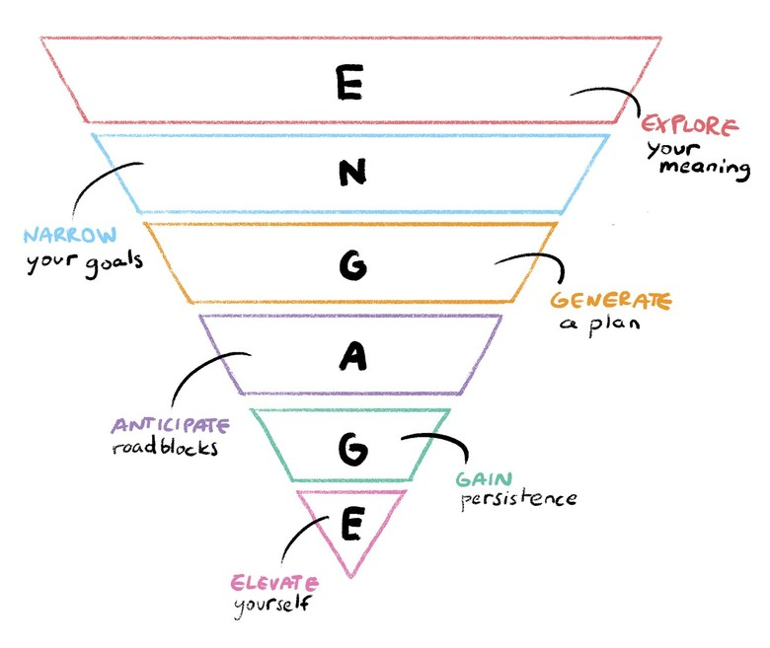
INF20028 Unit Success: Formula
Engage with the unit & your classmates
Be disciplined & follow routines
Explore all of the materials provided to you
Watch, Listen, take notes
Look for linkages between the theory to the assignments
Achieve little victories
Reflect
Strive for progress not perfection

Slide 25

Perfection is a Myth
Interpret what is being said on this slide. Read between the lines.
HD is exceptional in ALL aspects. HIGH Distinction
Qualitative vs. Quantitative
Level of depth of analysis
Ability to synthesise literature
Focus on Progress, not Perfection
Professional Growth Mindset
A rising tide lifts all boats
Have a crack at it

Slide 26

Week 1 Action Items: Your check list to be completed
Watch the theory recordings for Week 2 & catchup on any Week 1 recordings you have yet to get to
Pay attention to the informal professional expectations slides
Checkout the Watercooler Conversations
Read the Assignment 1 guidelines and clarify any issues with the Teaching Team
Move yourself into a group at the start of Week 2
Reflect on what’s working & what’s not.

Slide 27


Virtual Coffee ‘Baristering’ Begins next week!
Optional, & informal drop-ins for online consultations.
Drop by a minute, 10 or as long as it takes (within limits)
No need to book and the sessions are not recorded.
Check the Collaborate Ultra link for the session.

Slide 28
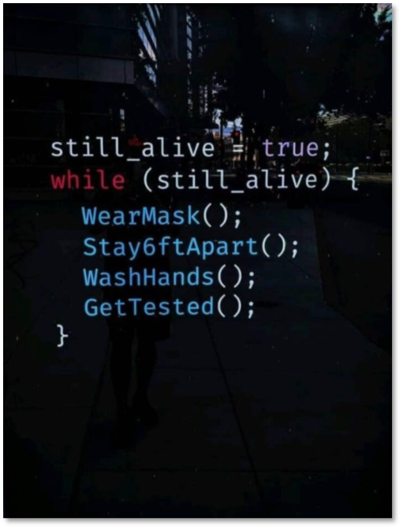
Be Vigilant
Watch your emails
Watch for unit announcements

Slide 29


The INF20028 Teaching Team’s expectations of YOUR capabilities as an ICT Professional (in-training)

Slide 30
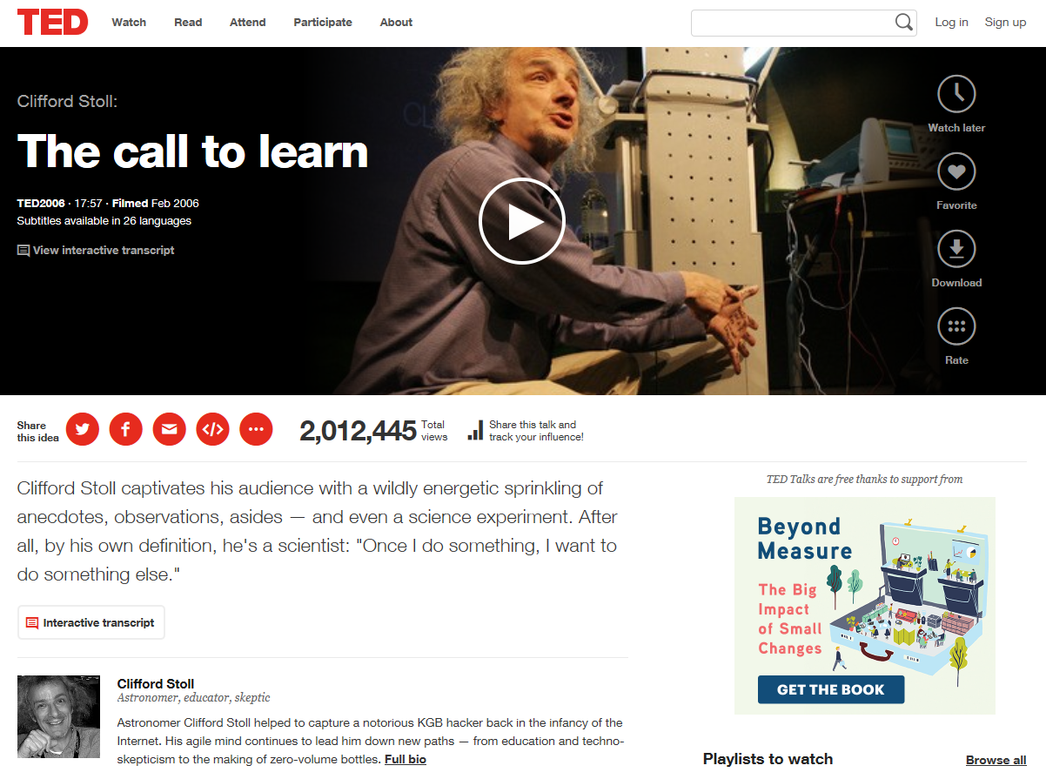

Be Passionate
This means being interested in what you’re doing.
Do something you have a great opportunity to LOVE.
This does not mean that you have to be hyperactively happy.
You can have an ‘off day’ and be grumpy, annoyed *&^%$# off.
I’m suggesting you be Passionate, not a Saint!

Slide 31
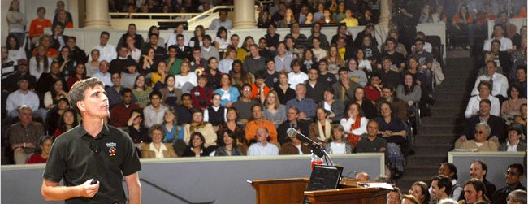
Be Passionate /2
The Last Lecture, Professor Randy Pausch, Carnegie Mellon (see YouTube)

Slide 32

Be Eager
Are you internally driven to make your organisation (your project team) a success and with it, yourself?

Slide 33

Be a Sponge
Be a lifelong learner. Soak up available knowledge.
Always be learning. Always be seeking out knowledge.
Always be growing.
Seek ways to do so.

Slide 34

Get better on weeknights & on weekends
It means constant improvement.
And if you want to make more, do more, then that means you hone your skills on nights and weekends.
It’s what your ‘competitors’ are doing

Slide 35

Get better on weeknights & on weekends /2
It means acquiring new skills
An ability to ‘smell fear’ is a quality I’ve never seen listed on a resume before!

Slide 36
Everybody starts somewhere
Everybody starts somewhere and typically that’s at the bottom of the ladder

Slide 37

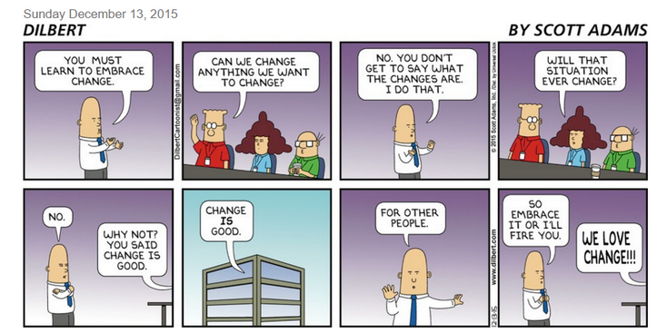
Be Flexible
Be willing to adapt and change if needed
Change is a constant

Slide 38


Be the Solution
Be someone who sees a problem and owns the solution
‘Selling’ that solution to a problem owner may not always be easy

Slide 39
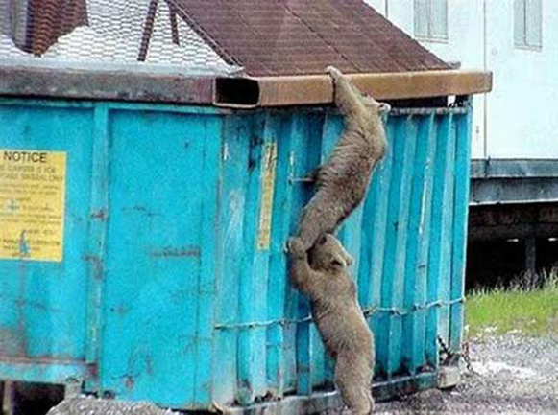
Be Helpful
It means helping someone else with their problem.
The outcome will be win-win

Slide 40

Find out how to fit in, QUICKLY
Find your place, quickly
Empirically (look, listen, take notice)
Don’t just change from Green to Gold
Instead, discover your unique role (colour) in your organisation and what you can contribute to that role

Slide 41


You’re not a rockstar!... yet
Don’t act like one until you have the ‘credibility’.
Play your part and recognize you are part pf a bigger picture
Recognise you rarely get to where you are without the backing & support of others
Lead singer or drummer...

Slide 42
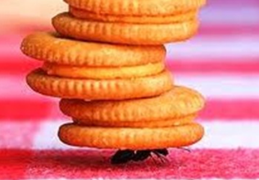

Show up, work hard and you will stand out
Try your best, every day and people will take notice

Slide 43


Be Intrinsic in your Motivation
Beware of analysis paralysis. Sometimes you just need to do IT, whatever IT is…
Reporter to Forrest Gump: “Why are you doing this?”
Forrest to the Reporter: “I just felt like running”
Notes:
Watch from the 3:15 mark

Slide 44
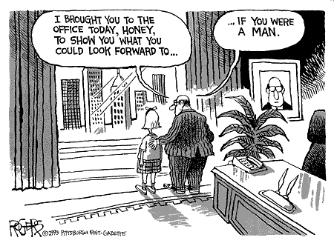
Be Diverse
A professional can always find their place in diversity

Slide 45


